Slide 1
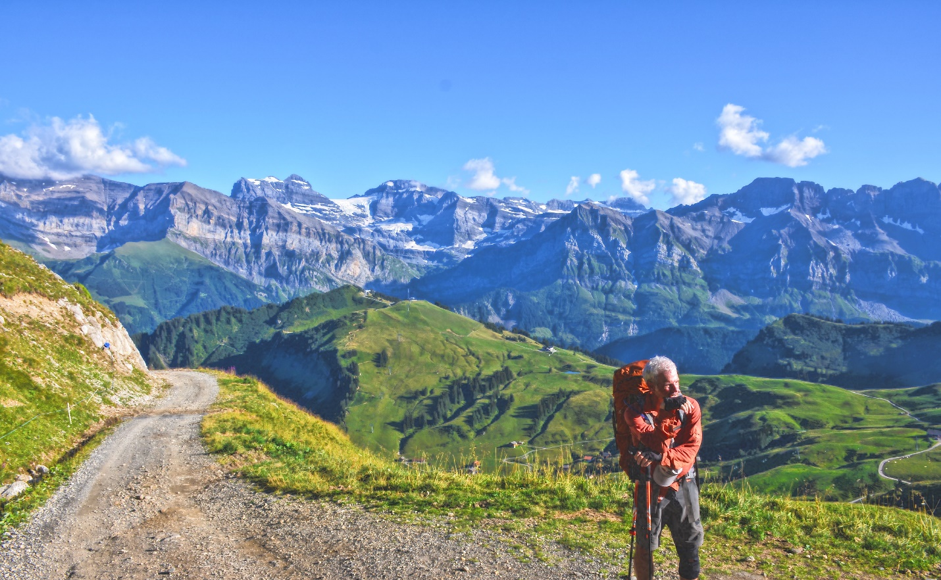
Take A Hike
The scenic route to life: A fast way to plan, implement and record your hiking adventures

Slide 2
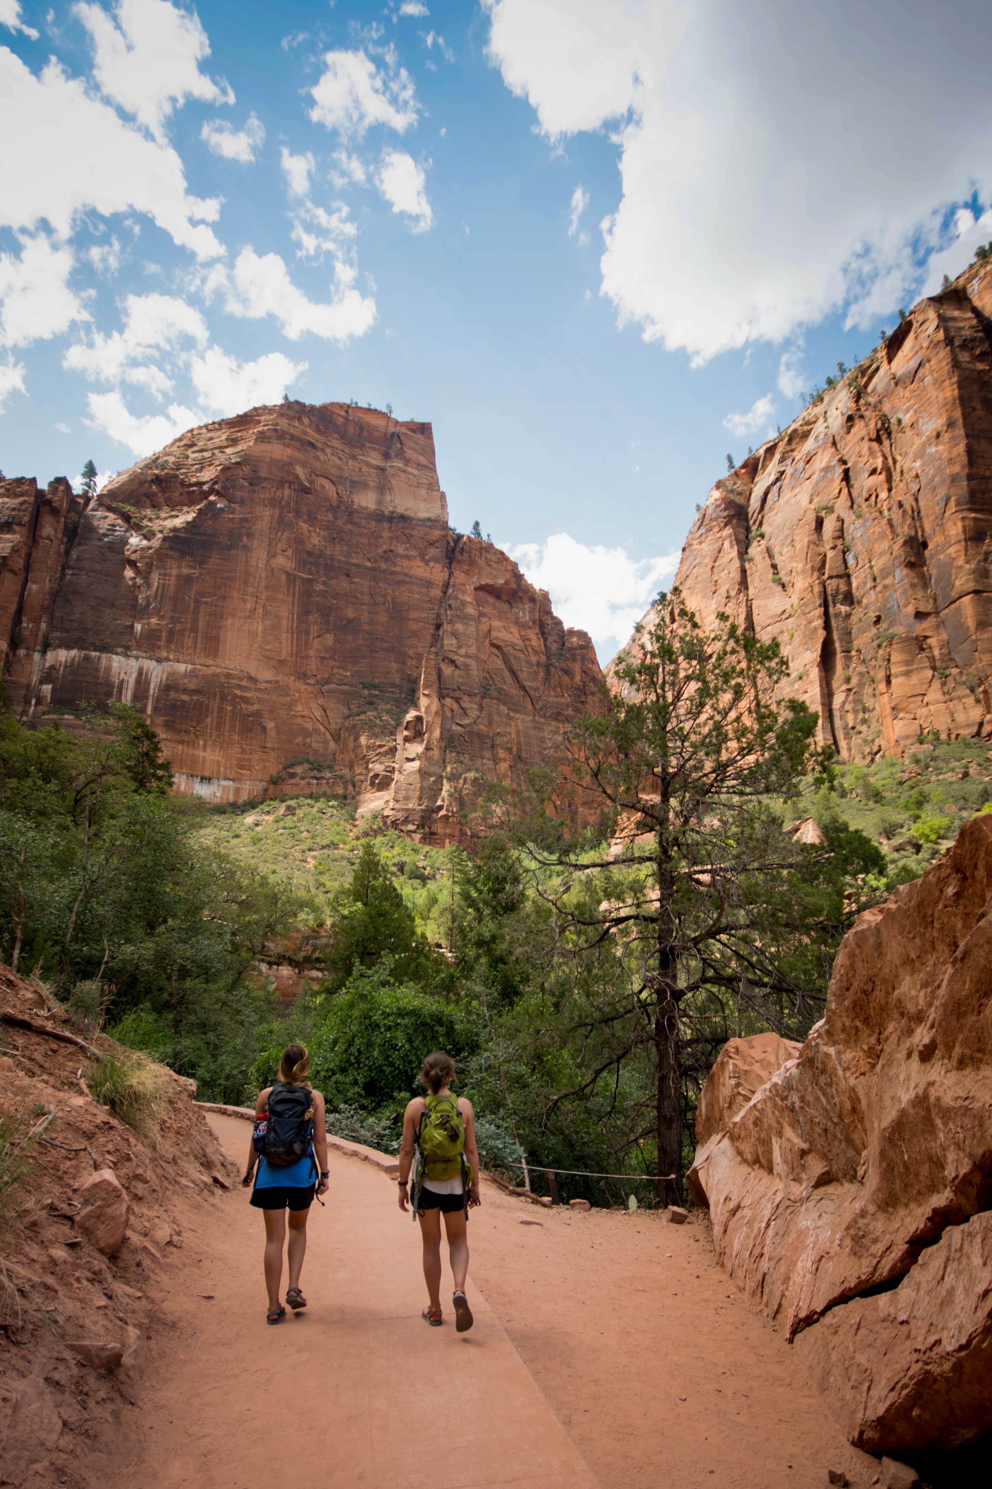
Choose an Experience
Adventure
Enthusiasm
Discovery

Slide 3
Travel Budget

Slide 4

Transportation
Car
Ride Share
Taxi
Rental
Air
Int.
Domestic
Rail
Railway

Slide 5
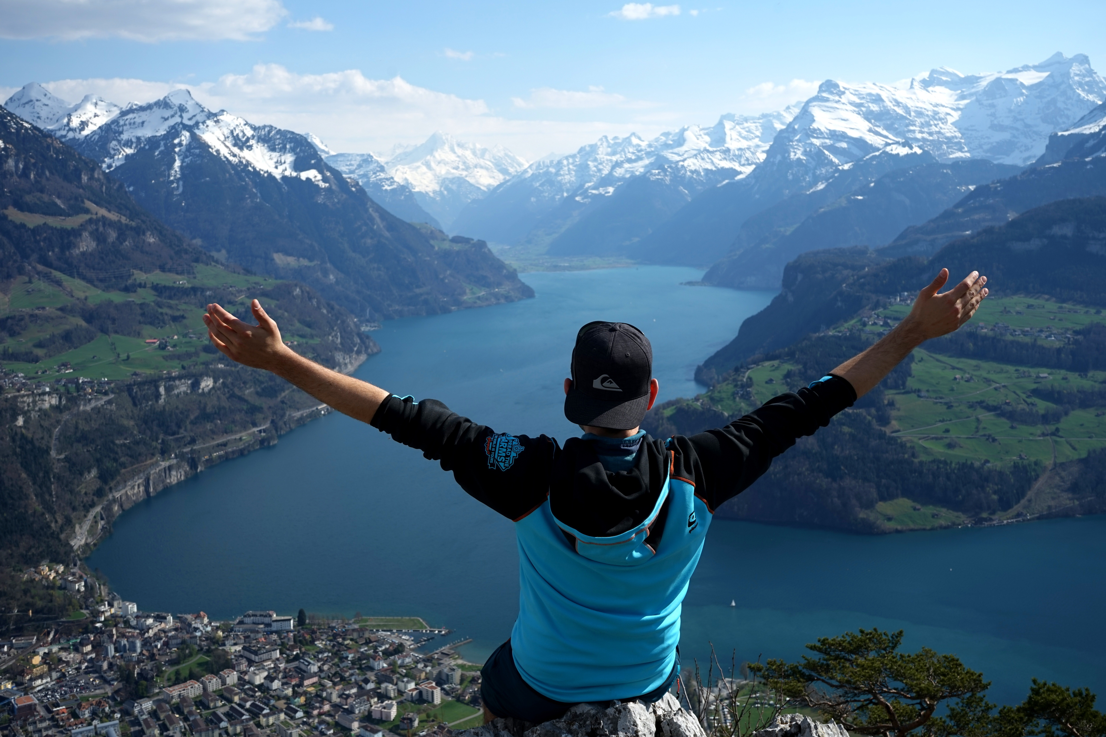
Thank You
someone@example.com

